Slide 1
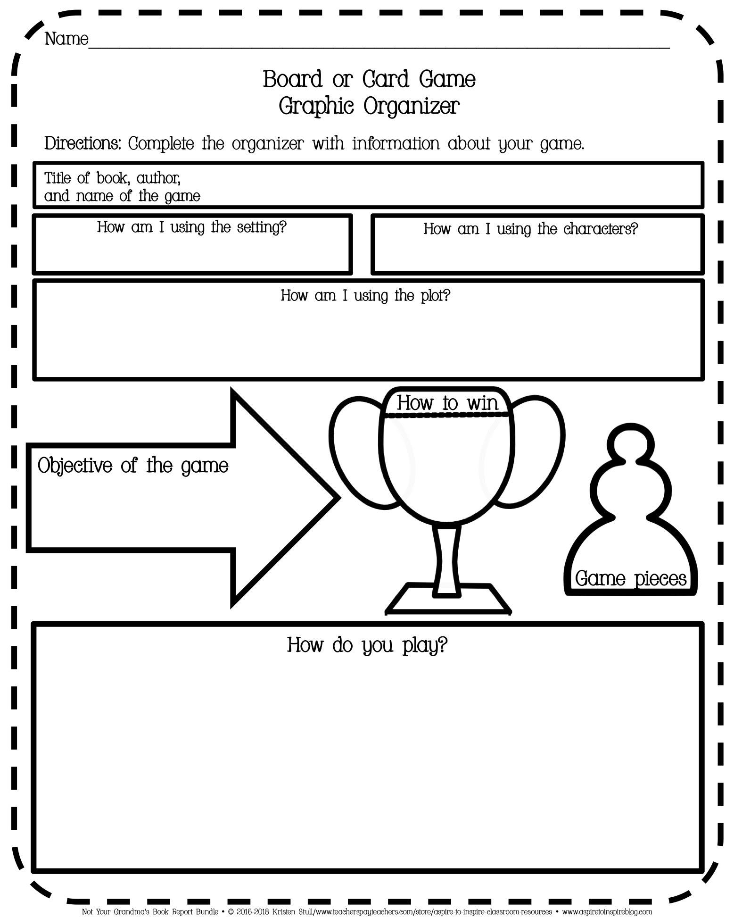
N/A
Type here
Type here
Type here
Type here
Type here
Type here
Type here
Type here
Notes:
Student: Click in the text box to type your responses. Text boxes can be resized and moved. Font size and type can be changed.

